Slide 1
Introduction to HTML

Slide 2
Definitions
W W W – World Wide Web.
HTML – HyperText Markup Language – The Language of Web Pages on the World Wide Web.
HTML is a text formatting language.
URL – Uniform Resource Locator.
Browser – A software program which is used to show web pages.

Slide 3
“Normal text” surrounded by bracketed tags that tell browsers how to display web pages
Pages end with “.htm” or “.html”
HTML Editor – A word processor that has been specialized to make the writing of HTML documents more effortless.
Notes:
09/22/97
3
University of Minnesota Extension Service
Master Internet Volunteer Program
Provide information in an organized way
Chat Groups
Specialized information areas
Internet access

Slide 4
Tags
Codes enclosed in brackets
Usually paired
<TITLE>My Web Page</TITLE>
Not case sensitive
<TITLE> = <title> = <TITLE>

Slide 5
Choosing Text Editor
There are many different programs that you can use to create web documents.
HTML Editors enable users to create documents quickly and easily by pushing a few buttons. Instead of entering all of the HTML codes by hand.
These programs will generate the HTML Source Code for you.

Slide 6
Creating a Basic Starting Document
<HTML>
<HEAD>
<TITLE>Al al-Bayt University</TITLE>
</HEAD>
<BODY>
This is what is displayed.
</BODY>
</HTML>
Notes:
09/22/97
9
University of Minnesota Extension Service
Master Internet Volunteer Program
Tech help should be a local or toll-free call
Is it available when you are using the net?
Will you get a real person or have to leave voice mail? (voice mail is OK if the response time is fast and during a time you are not connected)
Try calling tech support before subscribing.

Slide 7
Using Image Background
The BODY element also gives you ability of setting an image as the document’s background.
An example of a background image’s HTML code is as follows:
<BODY BACKGROUND=“hi.gif” BGCOLOR=“#FFFFFF”></BODY>

Slide 8
Previewing Your Work
Once you have created your basic starting document and set your document properties it is a good idea to save your file.
To save a file, in NotePad, follow these steps:
Locate and click on the menu called “File”.
Select the option under File Menu labeled “Save As”.
In the “File Name” text box, type in the entire name of your file (including the extension name .html).

Slide 9
Headings, Paragraphs, Breaks & Horizontal Rules
In this chapter you will add headings to your page, insert paragraphs, add some breaks, and add horizontal rules.
Objectives
Upon completing this section, you should be able to
List and describe the different Heading elements.
Use Paragraphs to add text to a document.
Insert breaks where necessary.
Add a Horizontal Rule.

Slide 10
Headings, <Hx> </Hx>
Inside the BODY element, heading elements H1 through H6 are generally used for major divisions of the document. Headings are permitted to appear in any order, but you will obtain the best results when your documents are displayed in a browser if you follow these guidelines:
H1: should be used as the highest level of heading, H2 as the next highest, and so forth.
You should not skip heading levels: e.g., an H3 should not appear after an H1, unless there is an H2 between them.

Slide 11
Headings, <Hx> </Hx>
<HTML>
<HEAD>
<TITLE> Example Page</TITLE>
</HEAD>
<BODY>
<H1> Heading 1 </H1>
<H2> Heading 2 </H2>
<H3> Heading 3 </H3>
<H4> Heading 4 </H4>
<H5> Heading 5 </H5>
<H6> Heading 6 </H6>
</BODY>
</HTML>
Heading 1
Heading 2
Heading 3
Heading 4
Heading 5
Heading 6

Slide 12
Paragraphs, <P> </P>
Paragraphs allow you to add text to a document in such a way that it will automatically adjust the end of line to suite the window size of the browser in which it is being displayed. Each line of text will stretch the entire length of the window.

Slide 13
Break, <BR>
Line breaks allow you to decide where the text will break on a line or continue to the end of the window.
A <BR> is an empty Element, meaning that it may contain attributes but it does not contain content.
The <BR> element does not have a closing tag.

Slide 14
Horizontal Rule, <HR>
The <HR> element causes the browser to display a horizontal line (rule) in your document.
<HR> does not use a closing tag, </HR>.

Slide 15
Horizontal Rule, <HR>
Attribute | Description | Default Value
SIZE | Height of the rule in pixels | 2 pixels
WIDTH | Width of the rule in pixels or percentage of screen width | 100%
NOSHADE | Draw the rule with a flat look instead of a 3D look | Not set (3D look)
ALIGN | Aligns the line (Left, Center, Right) | Center
COLOR | Sets a color for the rule (IE 3.0 or later) | Not set

Slide 16
Bold, Italic and other Character Formatting Elements
<FONT SIZE=“+2”> Two sizes bigger</FONT>
The size attribute can be set as an absolute value from 1 to 7 or as a relative value using the “+” or “-” sign. Normal text size is 3 (from -2 to +4).
<B> Bold </B>
<I> Italic </I>
<U> Underline </U>
Color = “#RRGGBB” The COLOR attribute of the FONT element. E.g., <FONT COLOR=“#RRGGBB”>this text has color</FONT>
<PRE> Preformatted </PRE> Text enclosed by PRE tags is displayed in a mono-spaced font. Spaces and line breaks are supported without additional elements or special characters.

Slide 17
Bold, Italic and other Character Formatting Elements
<EM> Emphasis </EM> Browsers usually display this as italics.
<STRONG> STRONG </STRONG> Browsers display this as bold.
<TT> TELETYPE </TT> Text is displayed in a mono-spaced font. A typewriter text, e.g. fixed-width font.
<CITE> Citation </CITE> represents a document citation (italics). For titles of books, films, etc. Typically displayed in italics. (A Beginner's Guide to HTML)

Slide 18
Alignment
Some elements have attributes for alignment (ALIGN) e.g. Headings, Paragraphs and Horizontal Rules.
The Three alignment values are : LEFT, RIGHT, CENTER.
<CENTER></CENTER> Will center elements.

Slide 19
Alignment
<DIV ALIGN=“value”></DIV> Represents a division in the document and can contain most other element type. The alignment attribute of the DIV element is well supported.
<TABLE></TABLE> Inside a TABLE, alignment can be set for each individual cell.

Slide 20
Special Characters & Symbols
These Characters are recognized in HTML as they begin with an ampersand and end with with a semi-colon e.g. &value; The value will either be an entity name or a standard ASCII character number. They are called escape sequences.
The next table represents some of the more commonly used special characters. For a comprehensive listing, visit the W3C’s section on special characters at: http://www.w3.org/MarkUp/HTMLPlus/htmlplus_13.html

Slide 21
Special Characters & Symbols
Special Character | Entity Name | Special Character | Entity Name
Ampersand | &amp; & | Greater-than sign | &gt; >
Asterisk | &lowast; ∗∗ | Less-than sign | &lt; <
Cent sign | &cent; ¢ | Non-breaking space | &nbsp;
Copyright | &copy; © | Quotation mark | &quot; "
Fraction one qtr | &frac14; ¼ | Registration mark | &reg; ®
Fraction one half | &frac12; ½ | Trademark sign | &trade; ™

Slide 22
Special Characters & Symbols
Additional escape sequences support accented characters, such as:
&ouml;
a lowercase o with an umlaut: ö
&ntilde;
a lowercase n with a tilde: ñ
&Egrave;
an uppercase E with a grave accent: È
NOTE: Unlike the rest of HTML, the escape sequences are case sensitive. You cannot, for instance, use &LT; instead of &lt;.

Slide 23
Additional Character Formatting Elements
<STRIKE> strike-through text</STRIKE>
DEL is used for STRIKE at the latest browsers
<BIG> places text in a big font</BIG>
<SMALL> places text in a small font</SMALL>
<SUB> places text in subscript position </SUB>
<SUP> places text in superscript style position </SUP>

Slide 24
Example
<P><STRIKE> strike-through text </STRIKE></BR>
<BIG>places text in a big font </BIG><BR>
<SMALL> places text in a small font</SMALL><BR>
<SUB> places text in subscript position </SUB>
Normal
<SUP> places text in superscript style position </SUP><BR> </P>

Slide 25
Lists
In this chapter you will learn how to create a variety of lists.
Objectives
Upon completing this section, you should be able to
Create an unordered list.
Create an ordered list.
Create a defined list.
Nest Lists.

Slide 26
List Elements
HTML supplies several list elements. Most list elements are composed of one or more <LI> (List Item) elements.
UL : Unordered List. Items in this list start with a list mark such as a bullet. Browsers will usually change the list mark in nested lists.
<UL>
<LI> List item …</LI>
<LI> List item …</LI>
</UL>
List item …
List item …

Slide 27
List Elements
You have the choice of three bullet types: disc(default), circle, square.
These are controlled in Netscape Navigator by the “TYPE” attribute for the <UL> element.
<UL TYPE=“square”>
<LI> List item …</LI>
<LI> List item …</LI>
<LI> List item …</LI>
</UL>
List item …
List item …
List item …

Slide 28
List Elements
TYPE | Numbering | Styles
1 | Arabic numbers | 1,2,3, ……
a | Lower alpha | a, b, c, ……
A | Upper alpha | A, B, C, ……
i | Lower roman | i, ii, iii, ……
I | Upper roman | I, II, III, ……

Slide 29
Images
<IMG>This element defines a graphic image on the page.
Image File (SRC:source): This value will be a URL (location of the image) E.g. http://www.domain.com/dir/file.ext or /dir/file.txt.
Alternate Text (ALT): This is a text field that describes an image or acts as a label. It is displayed when they position the cursor over a graphic image.
Alignment (ALIGN): This allows you to align the image on your page.

Slide 30
Anchors, URLs and Image Maps
In this chapter you will learn about Uniform Resource Locator, and how to add them as Anchor or Links inside your web pages.
Objectives
Upon completing this section, you should be able to
Insert links into documents.
Define Link Types.
Define URL.
List some commonly used URLs.
Plan an Image Map.

Slide 31
HOW TO MAKE A LINK
1) The tags used to produce links are the <A>
and </A>. The <A> tells where the link should start and
the </A> indicates where the link ends. Everything between
these two will work as a link.
2) The example below shows how to make the word
Here work as a link to yahoo.
Click <A HREF="http://www.yahoo.com">here</A> to
go to yahoo.

Slide 32
Image Maps
Image maps are images, usually in gif format that have been divided into regions; clicking in a region of the image cause the web surfer to be connected to a new URL. Image maps are graphical form of creating links between pages.
There are two type of image maps:
Client side and server side
Both types of image maps involve a listing of co-ordinates
that define the mapping regions and which URLs those
coordinates are associated with. This is known as the map
file.

Slide 33
Tables
In this chapter you will learn that tables have many uses in
HTML.
Objectives:
Upon completing this section, you should be able to:
Insert a table.
Explain a table’s attributes.
Edit a table.
Add a table header.

Slide 34
Tables
The <TABLE></TABLE> element has four sub-elements:
Table Row<TR></TR>.
Table Header <TH></TH>.
Table Data <TD></TD>.
Caption <CAPTION></CAPTION>.
The table row elements usually contain table header elements or table data elements.

Slide 35
Tables
<table border=“1”>
<tr>
<th> Column 1 header </th>
<th> Column 2 header </th>
</tr>
<tr>
<td> Row1, Col1 </td>
<td> Row1, Col2 </td>
</tr>
<tr>
<td> Row2, Col1 </td>
<td> Row2, Col2 </td>
</tr>
</table>

Slide 36
Tables
Column 1 Header | Column 2 Header
Row1, Col1 | Row1, Col2
Row2, Col1 | Row2, Col2

Slide 37
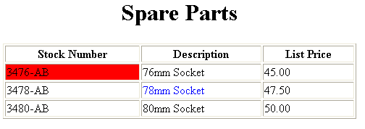
Basic Table Code
<TABLE BORDER=1 width=50%>
<CAPTION> <h1>Spare Parts <h1> </Caption>
<TR><TH>Stock Number</TH><TH>Description</TH><TH>List Price</TH></TR>
<TR><TD bgcolor=red>3476-AB</TD><TD>76mm Socket</TD><TD>45.00</TD></TR>
<TR><TD >3478-AB</TD><TD><font color=blue>78mm Socket</font> </TD><TD>47.50</TD></TR>
<TR><TD>3480-AB</TD><TD>80mm Socket</TD><TD>50.00</TD></TR>
</TABLE>

Slide 38
Forms
Forms add the ability to web pages to not only provide the person viewing the document with dynamic information but also to obtain information from the person viewing it, and process the information.
Objectives:
Upon completing this section, you should be able to
Create a FORM.
Add elements to a FORM.
Define CGI (Common Gateway Interface).
Describe the purpose of a CGI Application.
Specify an action for the FORM.
Forms work in all browsers.
Forms are Platform Independent.

Slide 39
Forms
To insert a form we use the <FORM></FORM> tags. The rest of the form elements must be inserted in between the form tags.
<HTML> <HEAD>
<TITLE> Sample Form</TITLE>
</HEAD>
<BODY BGCOLOR=“FFFFFF”>
<FORM ACTION = http://www.xnu.com/formtest.asp>
<P> First Name: <INPUT TYPE=“TEXT” NAME=“fname” MAXLENGTH=“50”> </P>
<P> <INPUT TYPE=“SUBMIT” NAME=“fsubmit1” VALUE=“Send Info”> </P>
</FORM>
</BODY> </HTML>

Slide 40
Form Elements
Form elements have properties: Text boxes, Password boxes, Checkboxes, Option(Radio) buttons, Submit, Reset, File, Hidden and Image.
The properties are specified in the TYPE Attribute of the HTML element <INPUT></INPUT>.

Slide 41
Form Elements
<INPUT> Element’s Properties
TYPE= Type of INPUT entry field.
NAME = Variable name passed to CGI application
VALUE= The data associated with the variable name to be passed to the CGI application
CHECKED= Button/box checked
SIZE= Number of visible characters in text field
MAXLENGHT= Maximum number of characters accepted.

Slide 42

Text Box
Text boxes: Used to provide input fields for text, phone numbers, dates, etc.
<INPUT TYPE= " TEXT " >
Browser will display
Textboxes use the following attributes:
TYPE: text.
SIZE: determines the size of the textbox in characters. Default=20 characters.
MAXLENGHT : determines the maximum number of characters that the field will accept.
NAME: is the name of the variable to be sent to the CGI application.
VALUE: will display its contents as the default value.

Slide 43
<HTML><HEAD>
<TITLE>RADIOBox</TITLE> </HEAD>
<BODY>
Form #1:
<FORM>
<INPUT TYPE="radio" NAME="choice" VALUE="one"> Yes.
<INPUT TYPE="radio" NAME="choice" VALUE="two"> No.
</FORM>
<HR color=red size="10" >
Form #2:
<FORM>
<INPUT TYPE="radio" NAME="choice" VALUE="three" CHECKED> Yes.
<INPUT TYPE="radio" NAME="choice" VALUE="four"> No.
</FORM>
</BODY></HTML>

Slide 44
<BODY bgcolor=lightblue>
<form>
<TEXTAREA COLS=40 ROWS=20 Name="comments" >
From observing the apathy of those
about me during flag raising I
concluded that patriotism if not
actually on the decline is at least
in a state of dormancy.
Written by Khaled Al-Fagih
</TEXTAREA>:
</form>
</BODY>

Slide 45
Password
Password: Used to allow entry of passwords.
<INPUT TYPE= " PASSWORD " >
Browser will display
Text typed in a password box is starred out in the browser
display.
Password boxes use the following attributes:
TYPE: password.
SIZE: determines the size of the textbox in characters.
MAXLENGHT: determines the maximum size of the password in characters.
NAME: is the name of the variable to be sent to the CGI application.
VALUE: is usually blank.

Slide 46
Example on Password Box
<HTML><HEAD>
<TITLE>Form_Password_Type</TITLE></HEAD>
<BODY>
<h1> <font color=red>To Access, Please
enter:</font></h1>
<FORM name="fome2" Action="url" method="get">
User Name: <INPUT TYPE="TEXT" Name="FName"
SIZE="15" MAXLENGTH="25"><BR>
Password: <INPUT TYPE="PASSWORD"
NAME="PWord" value="" SIZE="15”
MAXLENGTH="25"><BR>
</FORM></BODY> </HTML>

Slide 47
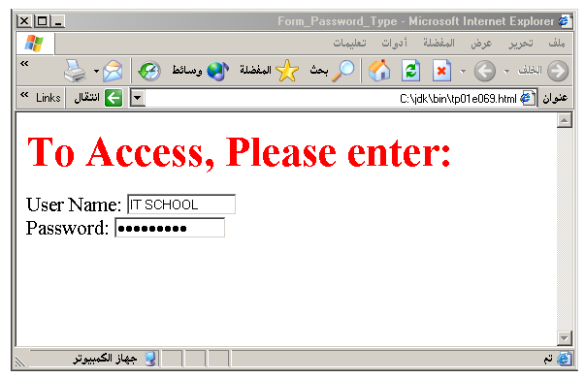
Output

Slide 48
Hidden
Hidden: Used to send data to the CGI application that you don’t want the web surfer to see, change or have to enter but is necessary for the application to process the form correctly.
<INPUT TYPE=“HIDDEN”>
Nothing is displayed in the browser.
Hidden inputs have the following attributes:
TYPE: hidden.
NAME: is the name of the variable to be sent to the CGI application.
VALUE: is usually set a value expected by the CGI application.

Slide 49
Check Box
Check Box: Check boxes allow the users to select more than one option.
<INPUT TYPE=“CHECKBOX”>
Browser will display
Checkboxes have the following attributes:
TYPE: checkbox.
CHECKED: is blank or CHECKED as the initial
status.
NAME: is the name of the variable to be sent to the
CGI application.
VALUE: is usually set to a value.

Slide 50
<HTML> <HEAD><TITLE>CheckBoxType</TITLE> </HEAD>
<BODY>
<h1> <font color=green>Please check one of the following</font></h1>
<FORM name="fome3" Action="url" method="get">
<font color=red> Select Country: </font><BR>
jordan:<INPUT TYPE="CheckBox" Name="country" CHECKED><BR>
Yemen<INPUT TYPE="CheckBox" Name="country"><BR>
Qatar:<INPUT TYPE="CheckBox" Name="country"><BR> <BR>
<font color=blue>Select Language:</font><BR>
Arabic:<INPUT TYPE="CheckBox" Name="language" CHECKED><BR> English:<INPUT TYPE="CheckBox" Name="language"><BR>
French:<INPUT TYPE="CheckBox" Name="language"> <BR></FORM> </BODY></HTML>

Slide 51
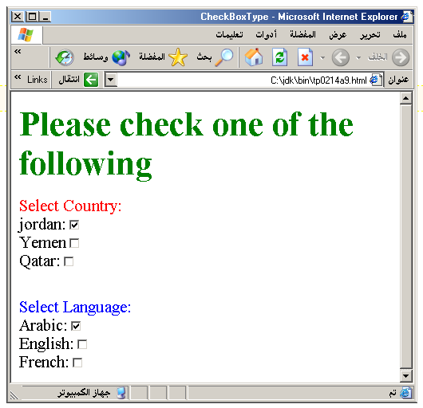
Output

Slide 52
Radio Button
Radio Button: Radio buttons allow the users to select
only one option.
<INPUT TYPE=“RADIO”>
Browser will display
Radio buttons have the following attributes:
TYPE: radio.
CHECKED: is blank or CHECKED as the initial
status. Only one radio button can be
checked
NAME: is the name of the variable to be sent to the
CGI application.
VALUE: usually has a set value.

Slide 53
<HTML> <HEAD><TITLE>CheckBoxType</TITLE> </HEAD>
<BODY>
<h1> <font color=green>Please check one of the following</font></h1>
<FORM name="fome3" Action="url" method="get">
<font color=red> Select Country: </font><BR>
jordan:<INPUT TYPE= "RADIO" Name="country" CHECKED><BR>
Yemen<INPUT TYPE="RADIO " Name="country"><BR>
Qatar:<INPUT TYPE="RADIO" Name="country"><BR> <BR>
<font color=blue>Select Language:</font><BR>
Arabic:<INPUT TYPE="RADIO" Name="language" CHECKED><BR> English:<INPUT TYPE=" RADIO " Name="language"><BR>
French:<INPUT TYPE=" RADIO " Name="language"> <BR></FORM> </BODY></HTML>

Slide 54
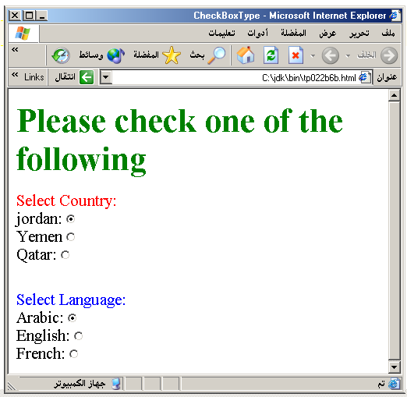

Slide 55
<HTML><HEAD>
<TITLE>RADIOBox</TITLE> </HEAD>
<BODY>
Form #1:
<FORM>
<INPUT TYPE="radio" NAME="choice" VALUE="one"> Yes.
<INPUT TYPE="radio" NAME="choice" VALUE="two"> No.
</FORM>
<HR color=red size="10" >
Form #2:
<FORM>
<INPUT TYPE="radio" NAME="choice" VALUE="three" CHECKED> Yes.
<INPUT TYPE="radio" NAME="choice" VALUE="four"> No.
</FORM>
</BODY></HTML>

Slide 56
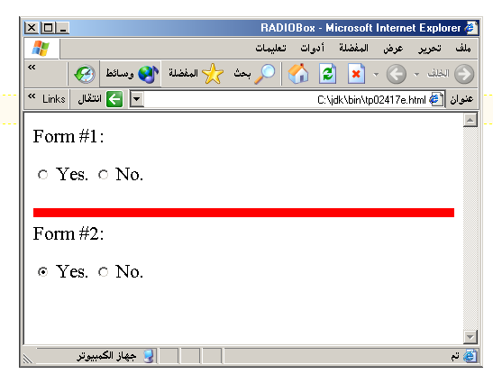
Output

Slide 57
Submit Button
Submit: Every set of Form tags requires a Submit button. This is the element causes the browser to send the names and values of the other elements to the CGI Application specified by the ACTION attribute of the FORM element.
<INPUT TYPE=“SUBMIT”>
The browser will display
Submit has the following attributes:
TYPE: submit.
NAME: value used by the CGI script for processing.
VALUE: determines the text label on the button, usually Submit Query.

Slide 58
<FORM Action="URL" method="get">
First Name: <INPUT TYPE="TEXT" Size=25 name="firstName"><BR>
Family Name: <INPUT TYPE="TEXT" Size=25 name="LastName"><BR>
<BR>
<FONT Color=red>
Press Here to submit the data:<BR>
<INPUT TYPE="submit" VALUE="SubmitData " >
</FORM>

Slide 59
Reset Button
Reset: It is a good idea to include one of these for each form where users are entering data. It allows the surfer to clear all the input in the form.
<INPUT TYPE=“RESET”>
Browser will display
Reset buttons have the following attributes:
TYPE: reset.
VALUE: determines the text label on the button, usually Reset.

Slide 60
<FORM Action="URL" method="get">
First Name: <INPUT TYPE="TEXT" Size=25 name="firstName"> <BR>
Family Name: <INPUT TYPE="TEXT" Size=25 name="LastName"><BR>
<BR>
<FONT Color = red>
<STRONG><font size=5>Press Here to submit the data:</font></STRONG><BR>
<INPUT TYPE="submit" VALUE="SubmitData">
<INPUT TYPE="RESET" VALUE="Reset">
</FORM>

Slide 61
<BODY bgcolor=lightblue>
<form>
<TEXTAREA COLS=40 ROWS=20 Name="comments" >
From observing the apathy of those
about me during flag raising I
concluded that patriotism if not
actually on the decline is at least
in a state of dormancy.
Written by Khaled Al-Fagih
</TEXTAREA>:
</form>
</BODY>

Slide 62
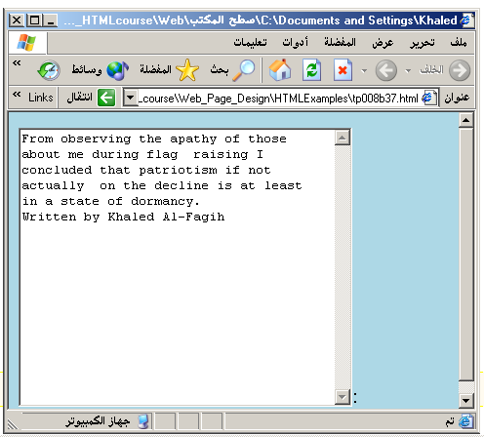

Slide 63
Other Elements used in Forms
Option
The list items are added to the <SELECT> element by inserting <OPTION></OPTION> elements.
The Option Element’s attributes are:
SELECTED: When this attribute is present, the option is selected when the document is initially loaded. It is an error for more than one option to be selected.
VALUE: Specifies the value the variable named in the select element.

Slide 64
<HEAD> <TITLE>SELECT with Mutiple </TITLE> </HEAD>
<BODY>
<h2><font color=blue>What type of Computer do you have?</font><h2>
<FORM>
<SELECT NAME="ComputerType" size=5 multiple>
<OPTION value="IBM" > IBM</OPTION>
<OPTION value="INTEL"> INTEL</OPTION>
<OPTION value=" Apple"> Apple</OPTION>
<OPTION value="Compaq" SELECTED> Compaq</OPTION>
<OPTION value=" other"> Other</OPTION>
</SELECT>
</FORM></BODY></HTML>

Slide 65
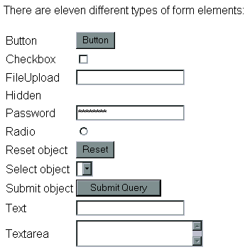

Slide 66
Style Sheet Languages
Cascading Style Sheets (CSS)
Applies to HTML as well as XML documents in general

Slide 67
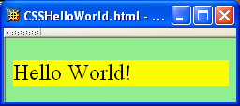
CSS Introduction
A styled HTML document produced by the style sheet style1.css:

Slide 68
CSS Introduction
link element associates style sheet with doc.

Slide 69
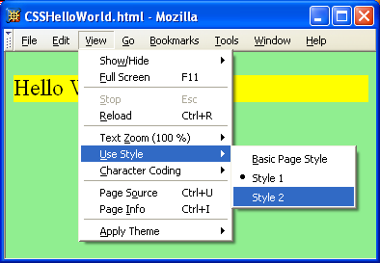
CSS Introduction

Slide 70
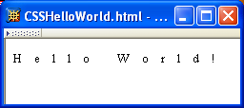
CSS Introduction
A styled HTML document produced by the style sheet style2.css:

Slide 71
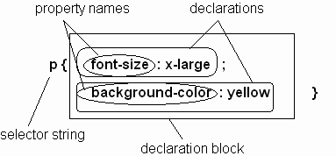
CSS Syntax
Parts of a style rule (or statement)

Slide 72
CSS Syntax: Selector Strings
Single element type:
Multiple element types:
All element types:
Specific elements by id:

Slide 73
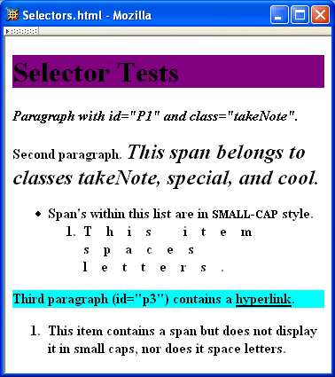
CSS Syntax: Selector Strings

Slide 74
CSS Syntax: Selector Strings
Elements belonging to a style class:
Referencing a style class in HTML:
Elements of a certain type and class:
class selector: begins with a period .

Slide 75
CSS Syntax: Selector Strings
Elements belonging to a style class:
Referencing a style class in HTML:
Elements of a certain type and class:
this span belongs to three style classes

Slide 76
CSS Syntax: Selector Strings
Elements belonging to a style class:
Referencing a style class in HTML:
Elements of a certain type and class:
this rule applies only to span’s belonging to class special

Slide 77
CSS Syntax: Selector Strings
Source anchor elements:
Element types that are descendents:
pseudo-classes

Slide 78
Types of style sheet
External Stylesheet
Internal Stylesheet
Embedded Stylesheet

Slide 79
Style Sheets and HTML
Rules of thumb:
Use external style sheets to define site-wide style
Prefer style sheets (either external or embedded) to style attributes

Slide 80
CSS Font Properties
A font family is a collection of related fonts (typically differ in size, weight, etc.)
font-family property can accept a list of families, including generic font families
first choice font

Slide 81
CSS Font Properties
A font family is a collection of related fonts (typically differ in size, weight, etc.)
font-family property can accept a list of families, including generic font families
second choice font

Slide 82
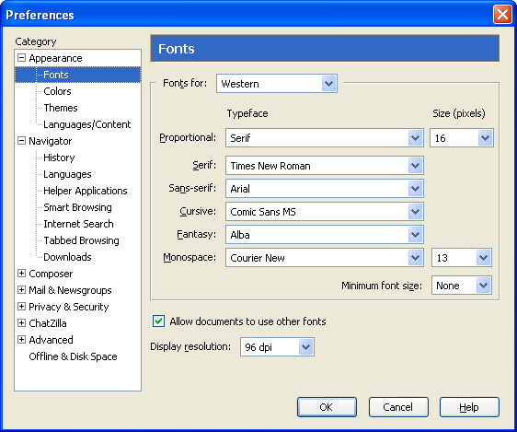
CSS Font Properties
generic
fonts are
system-
specific

Slide 83
CSS Text Color
Font color specified by color property
Two primary ways of specifying colors:
Color name: black, gray, silver, white, red, lime, blue, yellow, aqua, fuchsia, maroon, green, navy, olive, teal, purple, full list at http://www.w3.org/TR/SVG11/types.html#ColorKeywords
red/green/blue (RGB) values

Slide 84
Internal Stylesheet Example
An internal style sheet should be used when a single document has a unique style. You define internal styles in the head section of an HTML page, by using the <style> tag

Slide 85
Example
<head> <style> hr {color:sienna;} p {margin-left:20px;} body {background-image:url("images/background.gif");} </style> </head>

Slide 86
Inline Stylesheet
An inline style loses many of the advantages of style sheets by mixing content with presentation. Use this method sparingly!
To use inline styles you use the style attribute in the relevant tag. The style attribute can contain any CSS property.
<p style="color:sienna;margin-left:20px;">This is a paragraph.</p>

Slide 87
CSS 3
CSS3 is the latest standard for CSS.
CSS3 is completely backwards-compatible with earlier versions of CSS.

Slide 88
New Features of CSS 3
Box Model
Backgrounds and Borders
Image Values and Replaced Content
Text Effects
2D/3D Transformations
Animations
Multiple Column Layout

Slide 89
Borders
div
{
border:2px solid;
padding:10px 40px;
background:green;
width:300px;
border-radius:25px;
}

Slide 90
The box-shadow Property
In CSS3, the box-shadow property is used to add shadow to boxes:
div { box-shadow: 10px 10px 5px pink; }

Slide 91
CSS3 Backgrounds
background properties:
background-size
background-origin
Eg
body
{
background:url(img_flwr.gif);
background-size:80px 60px;
background-repeat:no-repeat;
padding-top:40px;
}

Slide 92
CSS Text Effects
text-shadow
h1 { text-shadow: 5px 5px 5px #FF0000; }

Slide 93
CSS text style
word-wrap
p
{
width:11em;
border:1px solid #000000;
word-wrap:break-word;
}

Slide 94
CSS3 2D Transforms
2d transform methods:
translate()
rotate()
scale()
skew()
matrix()
Notes:
div
{
-ms-transform: rotate(30deg); /* IE 9 */
-webkit-transform: rotate(30deg); /* Chrome, Safari, Opera */
transform: rotate(30deg);
}
div
{
-ms-transform: translate(50px,100px); /* IE 9 */
-webkit-transform: translate(50px,100px); /* Chrome, Safari, Opera */
transform: translate(50px,100px);
}
div
{
-ms-transform: rotate(30deg); /* IE 9 */
-webkit-transform: rotate(30deg); /* Chrome, Safari, Opera */
transform: rotate(30deg);
}
div
{
-ms-transform: scale(2,4); /* IE 9 */
-webkit-transform: scale(2,4); /* Chrome, Safari, Opera */
transform: scale(2,4);
}
div
{
-ms-transform: skew(30deg,20deg); /* IE 9 */
-webkit-transform: skew(30deg,20deg); /* Chrome, Safari, Opera */
transform: skew(30deg,20deg);
}
div
{
-ms-transform:matrix(0.866,0.5,-0.5,0.866,0,0); /* IE 9 */
-webkit-transform:matrix(0.866,0.5,-0.5,0.866,0,0); /* Chrome, Safari, Opera */
transform:matrix(0.866,0.5,-0.5,0.866,0,0);
}

Slide 95
CSS3 Transitions
CSS3 transitions are effects that let an element gradually change from one style to another.
The CSS property you want to add an effect to
The duration of the effect
Notes:
<!DOCTYPE html>
<html>
<head>
<style>
div
{
width:100px;
height:100px;
background:red;
-webkit-transition:width 2s; /* For Safari 3.1 to 6.0 */
transition:width 2s;
}
div:hover
{
width:300px;
}
</style>
</head>
<body>
<div></div>
<p>Hover over the div element above, to see the transition effect.</p>
</body>
</html>

Slide 96
Bind the animation to a selector (element) by specifying at least these two properties:
the name of the animation
the duration of the animation
Notes:
<!DOCTYPE html>
<html>
<head>
<style>
div
{
width:100px;
height:100px;
background:red;
-webkit-animation:myfirst 5s; /* Chrome, Safari, Opera */
animation:myfirst 5s;
}
/* Chrome, Safari, Opera */
@-webkit-keyframes myfirst
{
0% {background:red;}
25% {background:yellow;}
50% {background:blue;}
100% {background:green;}
}
/* Standard syntax */
@keyframes myfirst
{
0% {background:red;}
25% {background:yellow;}
50% {background:blue;}
100% {background:green;}
}
</style>
</head>
<body>
<div></div>
</body>
</html>

Slide 97
CSS Multiple Column
.newspaper { -webkit-column-count:3; /* Chrome, Safari, Opera */ -moz-column-count:3; /* Firefox */ column-count:3; }
Usage
<div class=“newspaper”>……</div>

Slide 98
Assignment
Design a web page using HTML which is for creating a brochure for a Cultural Fest 2014 at ITC Learning Center on 21st June 2013.
Include registration form which registers participants for various cultural events like Light Music,Inaguration song ,Dance,Mimickery and other cultural events.
Apply styles,HTML 4 and HTML 5 tags

Slide 100
JAVA Script

Slide 101
client-side programming with JavaScript
scripts vs. programs
JavaScript vs. JScript vs. VBScript
common tasks for client-side scripts
JavaScript
data types & expressions
control statements
functions & libraries
strings & arrays
Date, document, navigator, user-defined classes

Slide 102
Client-Side Programming
HTML is good for developing static pages
can specify text/image layout, presentation, links, …
Web page looks the same each time it is accessed
in order to develop interactive/reactive pages, must integrate programming in some form or another
client-side programming
programs are written in a separate programming (or scripting) language
e.g., JavaScript, JScript, VBScript
programs are embedded in the HTML of a Web page, with (HTML) tags to identify the program component
e.g., <script type="text/javascript"> … </script>
the browser executes the program as it loads the page, integrating the dynamic output of the program with the static content of HTML
could also allow the user (client) to input information and process it, might be used to validate input before it’s submitted to a remote server

Slide 103
Scripts vs. Programs
a scripting language is a simple, interpreted programming language
scripts are embedded as plain text, interpreted by application
simpler execution model: don't need compiler or development environment
saves bandwidth: source code is downloaded, not compiled executable
platform-independence: code interpreted by any script-enabled browser
but: slower than compiled code, not as powerful/full-featured
JavaScript: the first Web scripting language, developed by Netscape in 1995
syntactic similarities to Java/C++, but simpler, more flexible in some respects,
limited in others
(loose typing, dynamic variables, simple objects)
JScript: Microsoft version of JavaScript, introduced in 1996
same core language, but some browser-specific differences
fortunately, IE, Netscape, Firefox, etc. can (mostly) handle both
JavaScript & JScript
JavaScript 1.5 & JScript 5.0 cores both conform to ECMAScript standard
VBScript: client-side scripting version of Microsoft Visual Basic

Slide 104
Common Scripting Tasks
adding dynamic features to Web pages
validation of form data (probably the most commonly used application)
image rollovers
time-sensitive or random page elements
handling cookies
defining programs with Web interfaces
utilize buttons, text boxes, clickable images, prompts, etc
limitations of client-side scripting
since script code is embedded in the page, it is viewable to the world
for security reasons, scripts are limited in what they can do
e.g., can't access the client's hard drive
since they are designed to run on any machine platform, scripts do not contain platform specific commands
script languages are not full-featured
e.g., JavaScript objects are very crude, not good for large project development

Slide 105
JavaScript
JavaScript code can be embedded in a Web page using <script> tags
the output of JavaScript code is displayed as if directly entered in HTML
document.write displays text in the page
text to be displayed can include HTML tags
the tags are interpreted by the browser when the text is displayed
as in C++/Java, statements end with ;
but a line break might also be interpreted as the end of a statement (depends upon browser)
JavaScript comments similar to C++/Java
// starts a single line comment
/*…*/ enclose multi-line comments
<html>
<!–- COMP519 js01.html 16.08.06 -->
<head>
<title>JavaScript Page</title>
</head>
<body>
<script type="text/javascript">
// silly code to demonstrate output
document.write("<p>Hello world!</p>");
document.write(" <p>How are <br/> " +
" <i>you</i>?</p> ");
</script>
<p>Here is some static text as well.</p>
</body>
</html>

Slide 106
JavaScript Data Types & Variables
JavaScript has only three primitive data types
String : "foo" 'how do you do?' "I said 'hi'." ""
Number: 12 3.14159 1.5E6
Boolean : true false *Find info on Null, Undefined
assignments are as in C++/Java
message = "howdy";
pi = 3.14159;
variable names are sequences of letters, digits, and underscores that start with a letter or an underscore
variables names are case-sensitive
you don't have to declare variables, will be created the first time used, but it’s better if you use var statements
var message, pi=3.14159;
variables are loosely typed, can be assigned different types of values (Danger!)
<html>
<!–- COMP519 js02.html 16.08.06 -->
<head>
<title>Data Types and Variables</title>
</head>
<body>
<script type="text/javascript">
var x, y;
x= 1024;
y=x; x = "foobar";
document.write("<p>x = " + y + "</p>");
document.write("<p>x = " + x + "</p>");
</script>
</body>
</html>

Slide 107
JavaScript Operators & Control Statements
standard C++/Java operators & control statements are provided in JavaScript
+, -, *, /, %, ++, --, …
==, !=, <, >, <=, >=
&&, ||, !,
if , if-else, switch
while, for, do-while, …
<html>
<!–- COMP519 js03.html 08.10.10 -->
<head>
<title>Folding Puzzle</title>
</head>
<body>
<script type="text/javascript">
var distanceToSun = 93.3e6*5280*12;
var thickness = .002;
var foldCount = 0;
while (thickness < distanceToSun) {
thickness *= 2;
foldCount++;
}
document.write("Number of folds = " +
foldCount);
</script>
</body>
</html>

Slide 108
JavaScript Math Routines
<html>
<!–- COMP519 js04.html 08.10.10 -->
<head>
<title>Random Dice Rolls</title>
</head>
<body>
<div style="text-align:center">
<script type="text/javascript">
var roll1 = Math.floor(Math.random()*6) + 1;
var roll2 = Math.floor(Math.random()*6) + 1;
document.write("<img src='http://www.csc.liv.ac.uk/"+
"~martin/teaching/comp519/Images/die" +
roll1 + ".gif‘ alt=‘dice showing ‘ + roll1 />");
document.write("&nbsp;&nbsp;");
document.write("<img src='http://www.csc.liv.ac.uk/"+
"~martin/teaching/comp519/Images/die" +
roll2 + ".gif‘ alt=‘dice showing ‘ + roll2 />");
</script>
</div>
</body>
</html>
the built-in Math object contains functions and constants
Math.sqrt
Math.pow
Math.abs
Math.max
Math.min
Math.floor
Math.ceil
Math.round
Math.PI
Math.E
Math.random function returns a real number in [0..1)

Slide 109
User-Defined Functions
function definitions are similar to C++/Java, except:
no return type for the function (since variables are loosely typed)
no variable typing for parameters (since variables are loosely typed)
by-value parameter passing only (parameter gets copy of argument)
function isPrime(n)
// Assumes: n > 0
// Returns: true if n is prime, else false
{
if (n < 2) {
return false;
}
else if (n == 2) {
return true;
}
else {
for (var i = 2; i <= Math.sqrt(n); i++) {
if (n % i == 0) {
return false;
}
}
return true;
}
}
Can limit variable scope to the function.
if the first use of a variable is preceded with var, then that variable is local to the function
for modularity, should make all variables in a function local

Slide 110
Function Example
<html>
<!–- COMP519 js06.html 16.08.2006 -->
<head>
<title>Prime Tester</title>
<script type="text/javascript">
function isPrime(n)
// Assumes: n > 0
// Returns: true if n is prime
{
// CODE AS SHOWN ON PREVIOUS SLIDE
}
</script>
</head>
<body>
<script type="text/javascript">
testNum = parseFloat(prompt("Enter a positive integer", "7"));
if (isPrime(testNum)) {
document.write(testNum + " <b>is</b> a prime number.");
}
else {
document.write(testNum + " <b>is not</b> a prime number.");
}
</script>
</body>
</html>
Function definitions (usually) go in the <head> section
<head> section is loaded first, so then the function is defined before code in the <body> is executed (and, therefore, the function can be used later in the body of the HTML document)

Slide 111
Array Example
<html>
<!–- COMP519 js10.html 11.10.2011 -->
<head>
<title>Die Statistics</title>
<script type="text/javascript"
src="http://www.csc.liv.ac.uk/~martin/teaching/comp519/JS/random.js">
</script>
</head>
<body>
<script type="text/javascript">
numRolls = 60000;
dieSides = 6;
rolls = new Array(dieSides+1);
for (i = 1; i < rolls.length; i++) {
rolls[i] = 0;
}
for(i = 1; i <= numRolls; i++) {
rolls[randomInt(1, dieSides)]++;
}
for (i = 1; i < rolls.length; i++) {
document.write("Number of " + i + "'s = " +
rolls[i] + "<br />");
}
</script>
</body>
</html>
suppose we want to simulate die rolls and verify even distribution
keep an array of counters:
initialize each count to 0
each time you roll X, increment rolls[X]
display each counter

Slide 112
Date Object
String & Array are the most commonly used objects in JavaScript
other, special purpose objects also exist
the Date object can be used to access the date and time
to create a Date object, use new & supply year/month/day/… as desired
today = new Date(); // sets to current date & time
newYear = new Date(2002,0,1); //sets to Jan 1, 2002 12:00AM
methods include:
newYear.getYear() can access individual components of a date
newYear.getMonth()
newYear.getDay()
newYear.getHours()
newYear.getMinutes()
newYear.getSeconds()
newYear.getMilliseconds()

Slide 113
Date Example
<html>
<!–- COMP519 js11.html 16.08.2006 -->
<head>
<title>Time page</title>
</head>
<body>
Time when page was loaded:
<script type="text/javascript">
now = new Date();
document.write("<p>" + now + "</p>");
time = "AM";
hours = now.getHours();
if (hours > 12) {
hours -= 12;
time = "PM"
}
else if (hours == 0) {
hours = 12;
}
document.write("<p>" + hours + ":" +
now.getMinutes() + ":" +
now.getSeconds() + " " +
time + "</p>");
</script>
</body>
</html>
by default, a date will be displayed in full, e.g.,
Sun Feb 03 22:55:20 GMT-0600 (Central Standard Time) 2002
can pull out portions of the date using the methods and display as desired
here, determine if "AM" or "PM" and adjust so hour between 1-12
10:55:20 PM

Slide 114
Another Example
<html>
<!–- COMP519 js12.html 12.10.2012 -->
<head>
<title>Time page</title>
</head>
<body>
<p>Elapsed time in this year:
<script type="text/javascript">
now = new Date();
newYear = new Date(2012,0,1);
secs = Math.round((now-newYear)/1000);
days = Math.floor(secs / 86400);
secs -= days*86400;
hours = Math.floor(secs / 3600);
secs -= hours*3600;
minutes = Math.floor(secs / 60);
secs -= minutes*60
document.write(days + " days, " +
hours + " hours, " +
minutes + " minutes, and " +
secs + " seconds.");
</script>
</p>
</body>
</html>
you can add and subtract Dates:
the result is a number of milliseconds
here, determine the number of seconds since New Year's day
(note: January is month 0)
divide into number of days, hours, minutes and seconds

Slide 115
document Object
Internet Explorer, Firefox, Opera, etc. allow you to access information about an HTML document using the document object
<html>
<!–- COMP519 js13.html 2.10.2012 -->
<head>
<title>Documentation page</title>
</head>
<body>
<table width="100%">
<tr>
<td><i>
<script type="text/javascript">
document.write(document.URL);
</script>
</i></td>
<td style="text-align: right;"><i>
<script type="text/javascript">
document.write(document.lastModified);
</script>
</i></td>
</tr>
</table>
</body>
</html>
document.write(…)
method that displays text in the page
document.URL
property that gives the location of the HTML document
document.lastModified
property that gives the date & time the HTML document was last changed

Slide 116
Object Example
<html>
<!–- COMP519 js15.html 11.10.2011 -->
<head>
<title>Dice page</title>
<script type="text/javascript"
src="Die.js">
</script>
</head>
<body>
<script type="text/javascript">
die6 = new Die(6);
die8 = new Die(8);
roll6 = -1; // dummy value to start loop
roll8 = -2; // dummy value to start loop
while (roll6 != roll8) {
roll6 = die6.roll();
roll8 = die8.roll();
document.write("6-sided: " + roll6 +
"&nbsp;&nbsp;&nbsp;&nbsp;" +
"8-sided: " + roll8 + "<br />");
}
document.write("<br />Number of rolls: " +
die6.numRolls);
</script>
</body>
</html>
create a Die object using new (similar to String and Array)
here, the argument to Die initializes numSides for that particular object
each Die object has its own properties (numSides & numRolls)
Roll(), when called on a particular Die, accesses its numSides property and updates its NumRolls

Slide 117
User-Defined Objects
can define new objects, but the notation can be somewhat awkward
simply define a function that serves as a constructor
specify data fields & methods using this
no data hiding: can't protect data or methods
// COMP519 Die.js 11.10.2011 //
// Die class definition
////////////////////////////////////////////
function Die(sides)
{
this.numSides = sides;
this.numRolls = 0;
this.roll = roll; // define a pointer to a function
}
function roll()
{
this.numRolls++;
return Math.floor(Math.random()*this.numSides) + 1;
}
define Die function (i.e., the object's constructor)
initialize data fields in the function, preceded with "this"
similarly, assign method to separately defined function (which uses this to access data)

Slide 118


HTML 5 Tutorial
Chapter 1
Introduction

Slide 119

What is HTML5?
HTML5 will be the new standard for HTML, XHTML, and the HTML DOM.
The previous version of HTML came in 1999. The web has changed a lot since then.
HTML5 is still a work in progress. However, most modern browsers have some HTML5 support.

Slide 120
How Did HTML5 Get Started?
HTML5 is a cooperation between the World Wide Web Consortium (W3C) and the Web Hypertext Application Technology Working Group (WHATWG).
WHATWG was working with web forms and applications, and W3C was working with XHTML 2.0. In 2006, they decided to cooperate and create a new version of HTML.
Some rules for HTML5 were established:
New features should be based on HTML, CSS, DOM, and JavaScript
Reduce the need for external plugins (like Flash)
Better error handling
More markup to replace scripting
HTML5 should be device independent
The development process should be visible to the public

Slide 121
New Features
Some of the most interesting new features in HTML5 :
The canvas element for drawing
The video and audio elements for media playback
Better support for local offline storage
New content specific elements, like article, footer, header, nav, section
New form controls, like calendar, date, time, email, url, search

Slide 122
Browser Support
HTML5 is not yet an official standard, and no browsers have full HTML5 support.
But all major browsers (Safari, Chrome, Firefox, Opera, Internet Explorer) continue to add new HTML5 features to their latest versions.

Slide 123
To start
<!doctype html>
And then
<meta charset=utf-8>

Slide 124
<header>,<nav>
<header>
<h1>My interesting life</h1>
</header>
<nav>
<h2>Menu</h2>
<ul>
<li><a href=”last-week.html”>Last week</a></li>
<li><a href=”archive.html”>Archives</a></li>
</ul>
</nav>

Slide 125
<article>
<article>
<h2>Yesterday</h2>
<p>Today I drank coffee for breakfast. 14 hours later,
I went to bed.</p>
</article>
<article>
<h2>Tuesday</h2>
<p>Ran out of coffee, so had orange juice for breakfast.
It was from concentrate.</p>
</article>

Slide 126
<footer>
<footer>
<small>&copy;2007 Ross Bruniges. Design by Blogging Tips
and Pearsonified</small>
</footer>

Slide 127
Canvas Element
Create a Canvas
<!DOCTYPE html>
<html>
<body>
<canvas id="myCanvas" width="200" height="100" style="border:1px solid #000000;">
Your browser does not support the HTML5 canvas tag.
</canvas>
</body>
</html>

Slide 128
JavaScript
All drawing on the canvas must be done inside a JavaScript:
<script> var c = document.getElementById("myCanvas"); var ctx = c.getContext("2d"); ctx.fillStyle = "#FF0000"; ctx.fillRect(0,0,150,75); </script>

Slide 129
Straight Line
<script>
var c = document.getElementById("myCanvas"); var ctx = c.getContext("2d"); ctx.moveTo(0,0); ctx.lineTo(200,100); ctx.stroke();
</script>

Slide 130
Video
<!DOCTYPE html>
<html>
<body>
<video width="320" height="240" controls>
<source src="movie.mp4" type="video/mp4">
<source src="movie.ogg" type="video/ogg">
Your browser does not support the video tag.
</video>
</body>
</html>

Slide 131
MIME Types support for video
MP4 video/mp4
WebM video/webm
Ogg video/ogg

Slide 132
Audio
<!DOCTYPE html>
<html>
<body>
<audio controls>
<source src="horse.ogg" type="audio/ogg">
<source src="horse.mp3" type="audio/mpeg">
Your browser does not support the audio element.
</audio>
</body>
</html>

Slide 133
HTML5 Web Storage Objects
HTML5 Web Storage provides two new objects for storing data on the client:
window.localStorage - stores data with no expiration date
code.sessionStorage - stores data for one session (data is lost when the tab is closed)

Slide 134
Local Storage
<!DOCTYPE html>
<html>
<body>
<div id="result"></div>
<script>
// Check browser support
if (typeof(Storage) != "undefined")
{
// Store
localStorage.setItem("lastname", "Smith");

Slide 135
Local Storage(Contd)
// Retrieve
document.getElementById("result").innerHTML=localStorage.getItem("lastname");
}
else
{
document.getElementById("result").innerHTML="Sorry, your browser does not support Web Storage...";
}
</script>

Slide 136
Session Storage
Example
Notes:
<!DOCTYPE html>
<html>
<head>
<script>
function clickCounter()
{
if(typeof(Storage)!=="undefined")
{
if (sessionStorage.clickcount)
{
sessionStorage.clickcount=Number(sessionStorage.clickcount)+1;
}
else
{
sessionStorage.clickcount=1;
}
document.getElementById("result").innerHTML="You have clicked the button " + sessionStorage.clickcount + " time(s) in this session.";
}
else
{
document.getElementById("result").innerHTML="Sorry, your browser does not support web storage...";
}
}
</script>
</head>
<body>
<p><button onclick="clickCounter()" type="button">Click me!</button></p>
<div id="result"></div>
</body>
</html>

Slide 137
New Input Elements
The new input types:
color
date
datetime
datetime-local
email
month
number
range
search
tel
time
url
week
Notes:
<!DOCTYPE html>
<html>
<head>
<script>
function clickCounter()
{
if(typeof(Storage)!=="undefined")
{
if (sessionStorage.clickcount)
{
sessionStorage.clickcount=Number(sessionStorage.clickcount)+1;
}
else
{
sessionStorage.clickcount=1;
}
document.getElementById("result").innerHTML="You have clicked the button " + sessionStorage.clickcount + " time(s) in this session.";
}
else
{
document.getElementById("result").innerHTML="Sorry, your browser does not support web storage...";
}
}
</script>
</head>
<body>
<p><button onclick="clickCounter()" type="button">Click me!</button></p>
<div id="result"></div>
</body>
</html>

Slide 138
Input type-Color
Input Type: color
The color type is used for input fields that should contain a color.
Example
Select a color from a color picker:
Select your favorite color: <input type="color" name="favcolor">

Slide 139
Input Type: date
Define a date control:
Birthday: <input type="date" name="bday">
Input Type: datetime
Define a date and time control (with time zone):
Birthday (date and time): <input type="datetime" name="bdaytime">
Input Type: datetime-local
Define a date and time control (no time zone):
Birthday (date and time): <input type="datetime-local" name="bdaytime">

Slide 140
Input type-Email
The email type is used for input fields that should contain an e-mail address.
Define a field for an e-mail address (will be automatically validated when submitted):
E-mail: <input type="email" name="email">

Slide 141
Input type-Month
Input Type: month
The month type allows the user to select a month and year.
Example
Define a month and year control (no time zone):
Birthday (month and year): <input type="month" name="bdaymonth">

Slide 142
Input Type-Number
The number type is used for input fields that should contain a numeric value.
Define a numeric field (with restrictions):
Quantity (between 1 and 5): <input type="number" name="quantity" min="1" max="5">

Slide 143
Input type-Search
The search type is used for search fields (a search field behaves like a regular text field).
Define a search field (like a site search, or Google search):
Search Google: <input type="search" name="googlesearch">

Slide 144
Input type-tel
The tel type is used for input fields that should contain a telephone number.
Define a field for entering a telephone number:
Telephone: <input type="tel" name="usrtel">
Not Supported by any browser

Slide 145
Input type-time
The time type allows the user to select a time.
Example
Define a control for entering a time (no time zone):
Select a time: <input type="time" name="usr_time">

Slide 146
Input type-URL
The url type is used for input fields that should contain a URL address.
The value of the url field is automatically validated when the form is submitted.
Example
Define a field for entering a URL:
Add your homepage: <input type="url" name="homepage">

Slide 147
Input type-Week
The week type allows the user to select a week and year.
Define a week and year control (no time zone):
Select a week: <input type="week" name="week_year">

